Slide 1
AIris: Smart Glasses for Smarter Learning
Name of the Guide
Dr. S. Thulasi Prasad
Batch No: A2
Presented By:
Kandukoori Sushma - 21911A0434
P. Ganesh - 21911A0445
Pantangi Anjali - 21911A0447
Katkuri Prem Kumar - 21911A0435

Slide 2
CONTENTS
Motivation
Objectives
Literature Survey
Selected Existing Methodology Scope
Problem Statement
Abstract of the Proposed Project
Introduction
Proposed Methodology with Block Diagram and Structural Diagram
Time Schedule of Work Progress
Results
Conclusion
References

Slide 3

MOTIVATION
With the increasing reliance on smartphones and computers for learning, distractions from ads and apps have become a major barrier to focused education. AIris: Smart Glasses for Smarter Learning aims to provide a hands-free, distraction-free learning experience by delivering real-time AI-powered responses directly to the user’s view. This ensures immediate access to information while maintaining focus and efficiency.

Slide 4
OBJECTIVES
Develop a wearable AI-powered learning assistant using an ESP32 microcontroller for processing, an OLED display for visual output, and an I2S MEMS microphone for capturing high-quality voice input with minimal noise.
Enable real-time speech-to-text conversion by implementing cloud-based APIs like Google Speech-to-Text or Deepgram, ensuring fast, accurate, and low-latency transcription of spoken input.
Integrate AI models (ChatGPT/Gemini) for instant query resolution by leveraging Wi-Fi connectivity on the ESP32, allowing users to receive reliable, AI-generated responses within seconds.
Ensure a distraction-free learning experience by eliminating ads, notifications, and unnecessary apps, allowing users to focus solely on educational content without interruptions.
Enhance accessibility for students, researchers, and professionals by offering hands-free, on-demand information retrieval, reducing the need for smartphones or laptops during learning sessions.

Slide 5
LITERATURE SURVEY
Title | Journal Name | Authors | Year | Technology | Key Findings
Use of Smart Glasses in Education-A Study | 2018 2nd International Conference on I-SMAC | N. M. Kumar, P. R. Krishna, P. K. Pagadala, N. M. Saravana Kumar | 2018 | Smart Glasses, Augmented Reality, Head-Mounted Displays (HMD) | Explores applications of smart glasses in education, including lecture recording, AR-based learning, and student concentration evaluation.
Construction of Smart Glasses Assisted Road Sign Recognition System | 2023 IEEE International Conference on Electrical, Automation and Computer Engineering (ICEACE) | K. Wu, Z. Xue | 2023 | Smart Glasses, Yolov5, Edge AI, Google Coral Board | Develops a road sign recognition system for visually impaired users using smart glasses with an HMD and edge AI processing.
AI-Powered Smart Glasses for Sensing and Recognition of Human-Robot Walking Environments | 2024 10th IEEE RAS/EMBS International Conference | Daniel Rossos, Alex Mihailidis, Brokoslaw Laschowski | 2024 | Raspberry Pi Pico, ArduCam HM0360, MobileNetV1, TensorFlow Lite Micro | Creates smart glasses for classifying walking terrains with 93.6% accuracy using a lightweight CNN model deployed on embedded hardware.
Advancements in Speech-to-Text Systems for the Hearing Impaired | 2024 IEEE North Karnataka Subsection Flagship International Conference (NKCon) | T. Y. G, N. B G, S. R. M, R. K, L. M. Mohamed | 2024 | Smart Glasses, Speech-to-Text, Google Speech Recognition, OLED, IoT, Bluetooth | Develops a speech-to-text system for hearing-impaired individuals, displaying transcriptions on an OLED screen embedded in smart glasses.

Slide 6
SELECTED EXISTING METHODOLOGY SCOPE
Low-Cost Smart Glass Using ESP32: Budget-friendly, AI-driven smart glasses with ESP32, OV2640 camera, MPU6050, and IR eye-blink detector. Features include object detection with voice output, text/sign-to-speech conversion, and obstacle avoidance.
Meta’s Ray-Ban Smart Glasses: High-end AI-powered wearable with a 12 MP camera, five-microphone array, and Meta AI assistant. Offers real-time translation, live streaming, open-ear audio, but is heavier (48.6g - 50.8g) and expensive ($299 - $379).
Google Glass: Launched in 2013 with a transparent HUD display, voice commands, and touchpad control but faced privacy concerns and limited AI functionality. Later evolved into Google Glass Enterprise Edition 2, targeting industrial and medical applications.

Slide 7
PROBLEM STATEMENT
In today’s digital world, students and professionals rely heavily on smartphones and computers for learning and research. However, these devices come with a major drawback—constant distractions from ads, notifications, and multiple applications that reduce focus and slow down the learning process. Even when using AI-powered tools like Google Assistant or ChatGPT, users must navigate through apps, deal with unwanted content, and shift attention between screens, leading to inefficient and interrupted learning.
AIris addresses this issue by offering a wearable AI-driven learning assistant that provides real-time, ad-free, and distraction-free access to information. By integrating speech recognition, AI processing, and a wearable display, AIris eliminates the need to constantly check a smartphone or compuer. This ensures seamless, hands-free interaction, allowing users to stay engaged in their studies without unnecessary interruptions. The device is particularly useful for students, researchers, and professionals who need quick access to knowledge without breaking concentration, ultimately making learning faster, more intuitive, and more efficient.

Slide 8
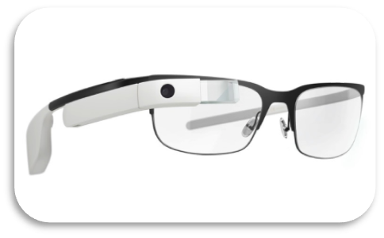
ABSTRACT OF THE PROPOSED PROJECT
This project focuses on the development of AIris: Smart Glasses for Smarter Learning, an AI-based wearable technology designed to enhance educational experiences. The glasses facilitate seamless interaction by accepting inputs through various devices (e.g., microphone, camera), activated by a simple button press. The input—whether speech or image—is converted into text using APIs supported by a Wi-Fi-enabled microcontroller. The text is then processed by large language models (LLMs) like ChatGPT or Gemini to generate insightful responses. These responses are displayed on an OLED screen and projected onto the lens using a reflection mechanism, providing a direct, intuitive view for the user. By combining AI with wearable tech, AIris aims to make learning more interactive, accessible, and efficient.

Slide 9
INTRODUCTION
The AIris: Smart Glasses for Smarter Learning project is an innovative AI-powered wearable designed to enhance educational experiences through real-time interaction. These smart glasses integrate artificial intelligence and edge computing to provide users with instant access to knowledge in a hands-free manner. Currently, the project focuses on speech-based input using an ESP32 microcontroller, an I2S MEMS microphone, and an OLED display to process and present information effectively.
By pressing a button, users can activate the voice-to-text feature, which captures spoken input through the I2S MEMS microphone. The recorded audio is then converted into text and processed by large language models (LLMs) such as ChatGPT or Gemini via API requests over Wi-Fi. The generated response is displayed on the OLED screen and projected onto the lens using a reflection mechanism, ensuring a seamless and intuitive user experience.
This combination of AI, IoT, and wearable technology makes AIris a valuable tool for students, researchers, and lifelong learners, offering real-time insights, improved accessibility, and interactive learning opportunities.

Slide 10
PROPOSED METHODOLOGY
Voice Input Capture: Uses an I2S MEMS microphone (INMP441), weighing just 3g, with a sensitivity of -26 dBFS and low noise performance for accurate speech detection.
Speech-to-Text Conversion: Utilizes cloud APIs like Google Speech-to-Text or Deepgram, achieving word error rates as low as 5% and transcription speeds under 300ms for real-time accuracy.
AI Processing: Queries are processed using ChatGPT or Gemini, with ESP32’s Wi-Fi providing response times of 500-800ms, ensuring efficient AI interactions.
Display Output: Responses are shown on an OLED screen and projected onto the lens, maintaining a brightness of ~100 nits for clear readability without obstructing vision.
Low-Latency Communication: The ESP32 microcontroller ensures Wi-Fi-based data exchange with a latency of <100ms, optimizing power efficiency for smooth AI interactions.
Lightweight design (~60g), considering the estimated weight breakdown: Display (6g) + ESP32 (10g) + INMP441 Mic (3g) + Battery (10g) + SD Card Module (5g) + Body & Glasses Frame (20g) + Zero PCB (5g) = ~60g, making AIris comfortable for extended wear.

Slide 11
BLOCK DIAGRAM
Deepgram Speech-to-text
Gemini LLM
ESP-32
Microcontroller
Physical lens for displaying the reflection of the OLED
User Input
INMP441 MIC MODULE
0.96-inch OLED Display
SD card module
18650 Battery charging/power Module

Slide 12
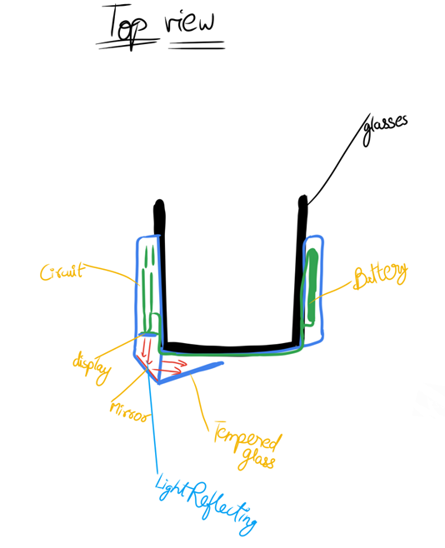
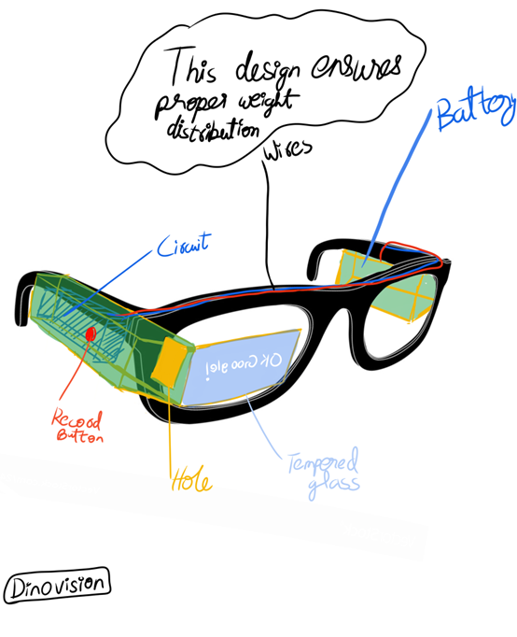
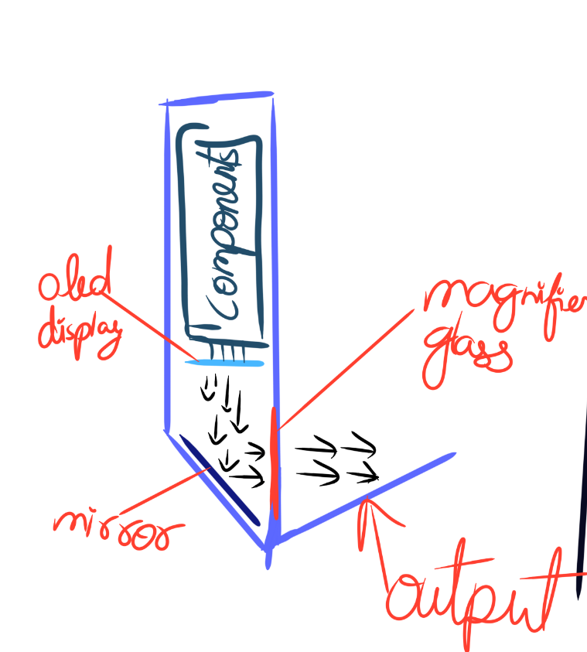
STRUCTURAL DIAGRAM OF THE DEVICE

Slide 13
TIME SCHEDULE OF WORK PROGRESS
Task | Timeline
Literature review & research | 15/1/2025 - 1/2/2025
OLED display & reflection setup | 2/2/2025 - 12/2/2025
Hardware selection & Coding | 13/2/2025 - 28/2/2025
Hardware Testing with Code | 1/3/2025 - 25/3/2025
Testing & refinement | 26/3/2025 - 5/4/2025
Final implementation & documentation | 6/4/2025 - 15/4/2025

Slide 14
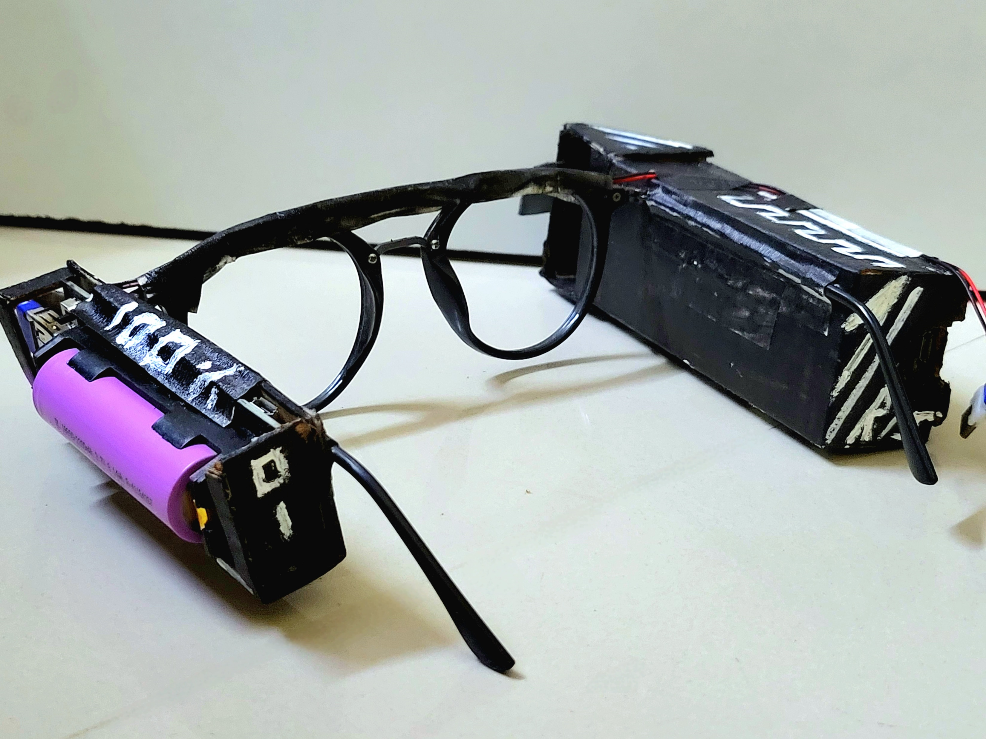
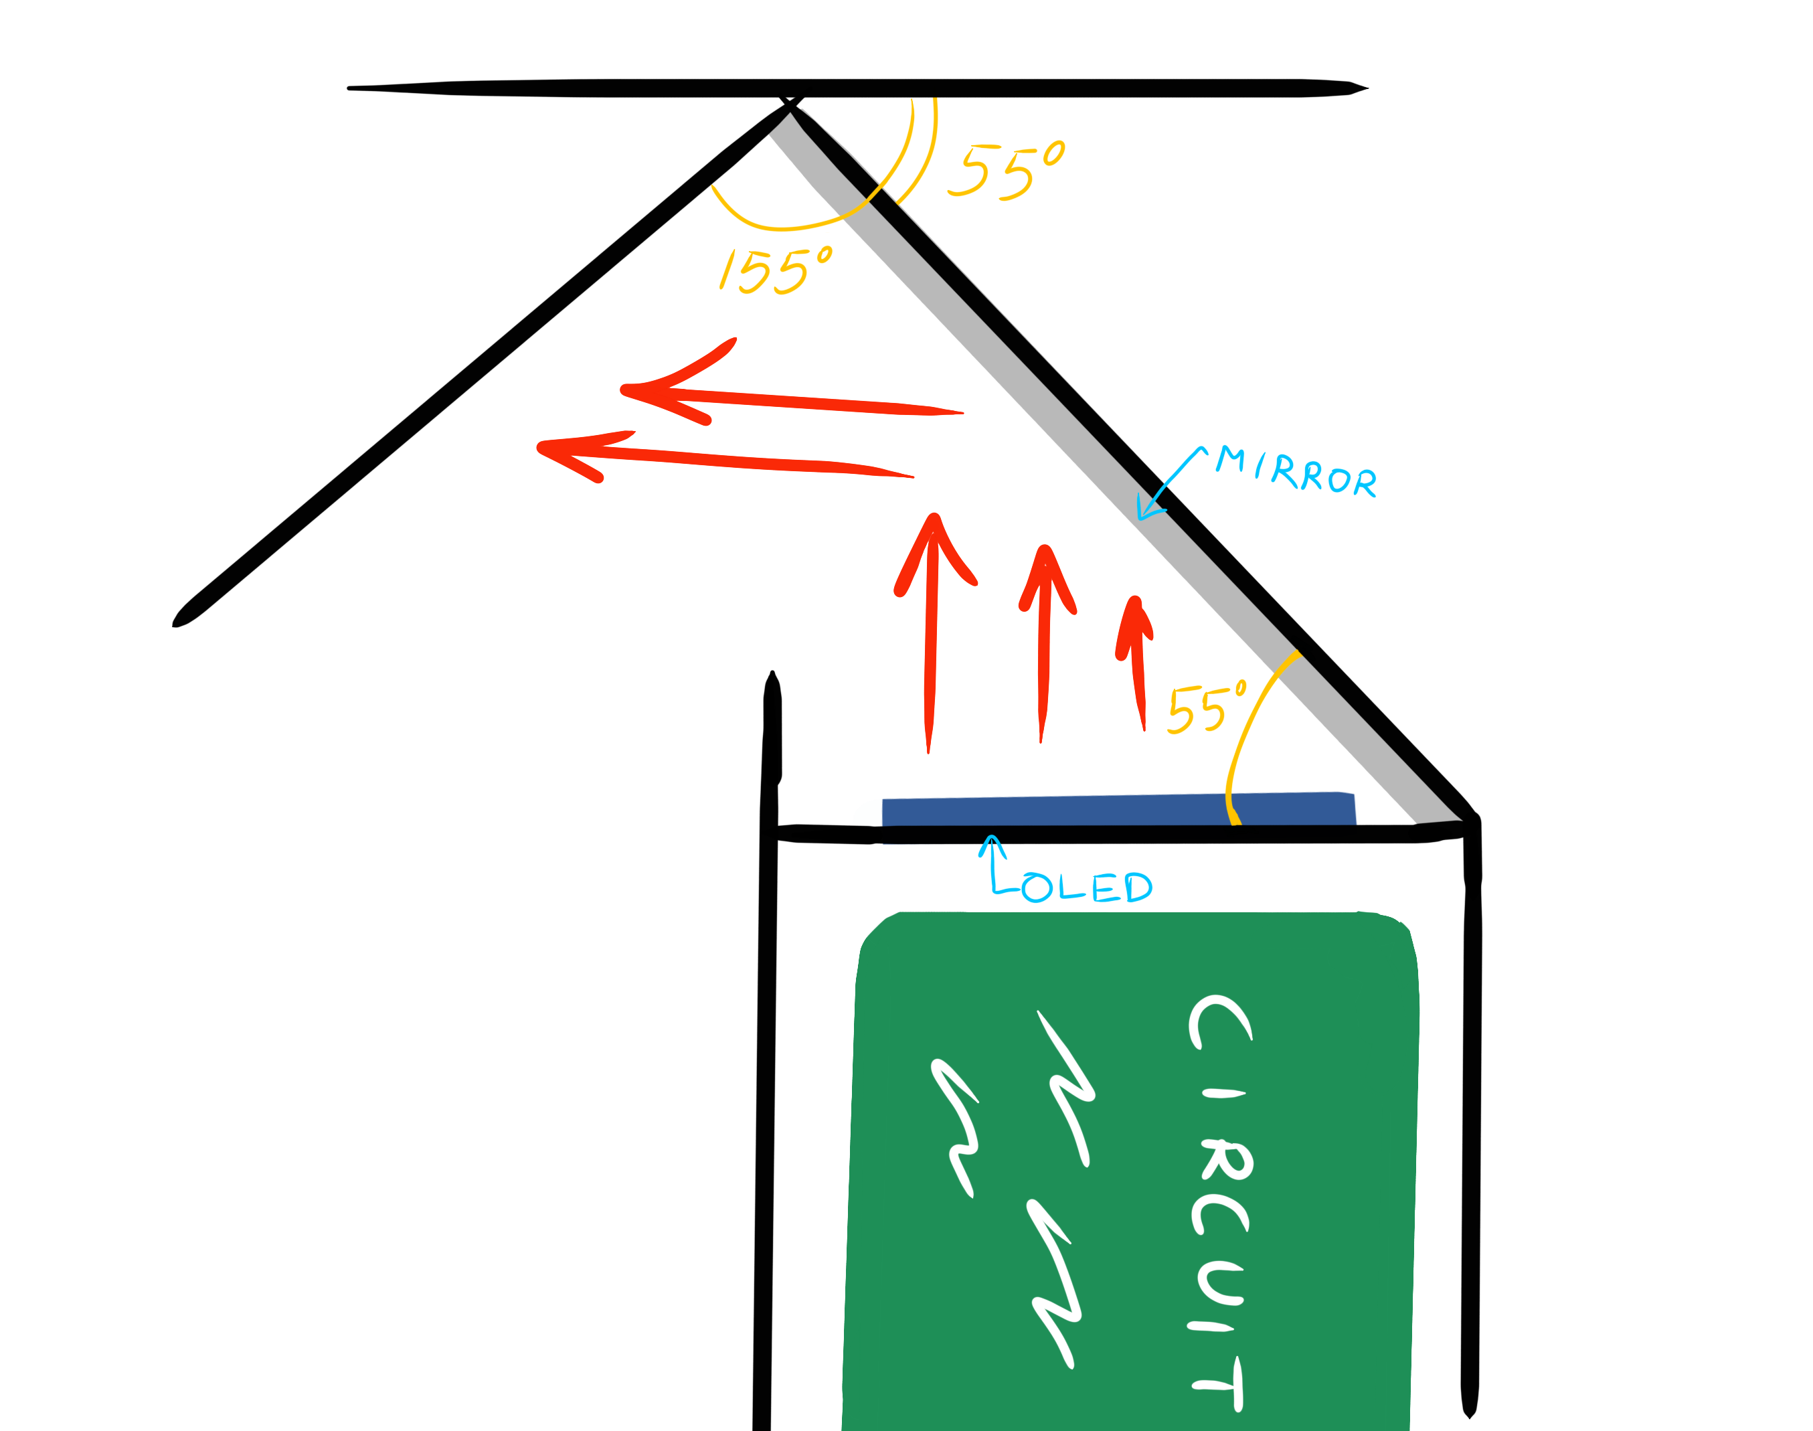
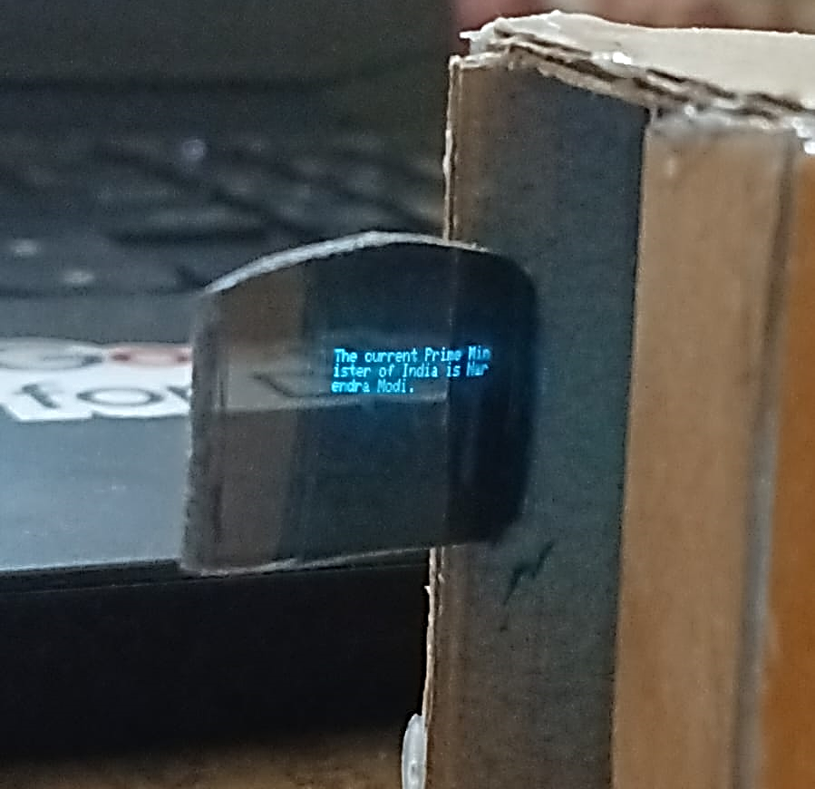
RESULTS
Button press activates the MEMS microphone; voice captured successfully.
Deepgram converts speech to text accurately; data stored temporarily on SD card.
Gemini API processes text and returns a contextual response.
OLED displays the response, which is reflected via mirror onto the transparent lens.

Slide 15
CONCLUSION
The prototype meets all key design requirements and functions as intended, showcasing a fully integrated, hands-free, AI-powered wearable display system for smarter learning. The system reliably captures voice input through the MEMS microphone, processes it in real time via Deepgram and Gemini APIs, and delivers clear textual output through an OLED display that is projected onto a transparent lens. This seamless integration of hardware and software confirms the system’s efficiency and robustness, offering an intuitive and distraction-free learning experience. Overall, the project demonstrates the feasibility of merging wearable technology with advanced AI assistance, while providing a strong foundation for future enhancements such as custom PCB development, improved optics, and a more compact design.

Slide 16
REFERENCES
T. Y. G, N. B. G, S. R. M, R. K and L. M. Mohamed. (2024) “Advancements in Speech-to-Text Systems for the Hearing Impaired”, 2024 IEEE North Karnataka Subsection Flagship International Conference (NKCon), Bagalkote, India, 2024.
D. Rossos, A. Mihailidis and B. Laschowski. (2024) “AI-Powered Smart Glasses for Sensing and Recognition of Human-Robot Walking Environments”, 2024 10th IEEE RAS/EMBS International Conference for Biomedical Robotics and Biomechatronics (BioRob), Heidelberg, Germany, 2024.
K. Wu and Z. Xue. (2023) “Construction of Smart Glasses Assisted Road Sign Recognition System”, 2023 IEEE International Conference on Electrical, Automation and Computer Engineering (ICEACE), Changchun, China, 2023.
S. Das, S. Saxena and N. K. Rout. (2021) “Low-Cost Smart-Glass using ESP-32”, 2021 IEEE 2nd International Conference on Applied Electromagnetics, Signal Processing, & Communication (AESPC), Bhubaneswar, India, 2021.
N. M. Kumar, P. R. Krishna, P. K. Pagadala and N. M. Saravana Kumar. (2018) “Use of Smart Glasses in Education-A Study”, 2018 2nd International Conference on I-SMAC (IoT in Social, Mobile, Analytics and Cloud) (I-SMAC), Palladam, India, 2018.

Slide 17
Thank You

